Slide 1
Perfios CDS-Internship-2022
_{(adapter)}
_{By:DILIP}

Slide 2
PROBLEM STATEMENT
To find alternatives to selenium python approach for web scraping that can perform all the functionalities present and more(if available) and try to subdue the limitations/challenges currently present. Any tech stack to suit the purpose of developing an end to end bank script for navigation and data parsing. Data to be fetched - personal information available in bank site and transaction history and present it in the required format.

Slide 3

Hello!
Introduction
Existing Methods and Disadvantages
Alternatives to Existing Model
Introduction To Puppeteer
Advantages and Differences
Flowchart of Working Model
Demo Of Working Model
Next Steps

Slide 4
Existing Model-selenium python
Disadvantages of selenium python
Selenium is a web-based automation tool.
Selenium combines with python to create an API like structure to enable web scraping.
Selenium combines with Python to provide a simple API for both automated testing as well as web scraping using Selenium WebDriver.
The Execution time taken is more resulting to a slower scraping process.
Dependency of Webdriver.

Slide 5
Alternatives to existing model -protractor,cypress and puppeteer
PROTRACTOR:
It is wrapped around selenium webdriver,it simulates user interaction with angular web applications
Maintenance has been stopped from 2021.
CYPRESS:
No multi-tab support
Very limited browser support
PUPPETEER:
Maintained by google
No webdriver dependency
Easy to code
Provides multi-tab support

Slide 6
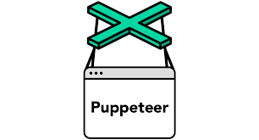
Introduction to puppeteer
Puppeteer is a js library which provides API to access and control Chromium.
Puppeteer widely used for web scraping.
Puppeteer has promises and async property (to handle async and await).

Slide 7
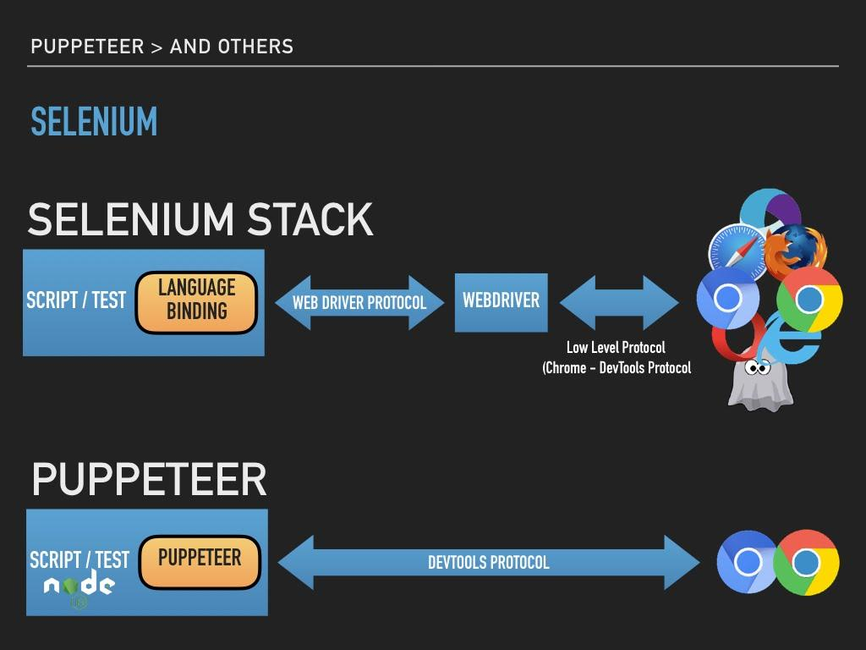
Comparison!
Puppeteer is a js library which provides API to access and control Chromium.
Puppeteer widely used for web scraping.
Puppeteer has promises and async property (to handle async and await).

Slide 8
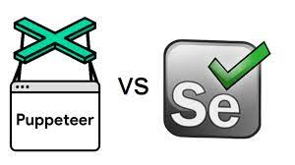
Lesser Execution time.
No dependency of WebDriver.
Provides optimized snippets such as :
await page.waitForSelector('’);
driver.find_element_by_xpath(‘’)
(Alternative to)

Slide 9
DEMOnstration!
Puppeteer Javascript:
https://drive.google.com/file/d/1e1N4zU2yqB5ylPVAkwJX6U4MOWke_cmN/view?usp=sharing
Selenium Python:
https://drive.google.com/file/d/1JDhKshmPu27PGiEGM0bKu9yFUy_pSVYD/view?usp=sharing

Slide 10
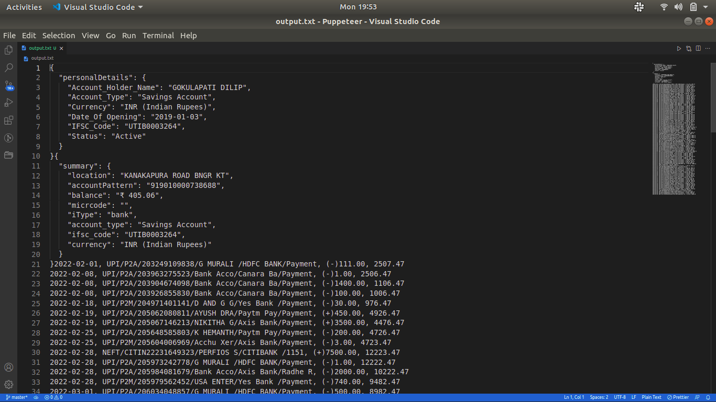

Slide 11
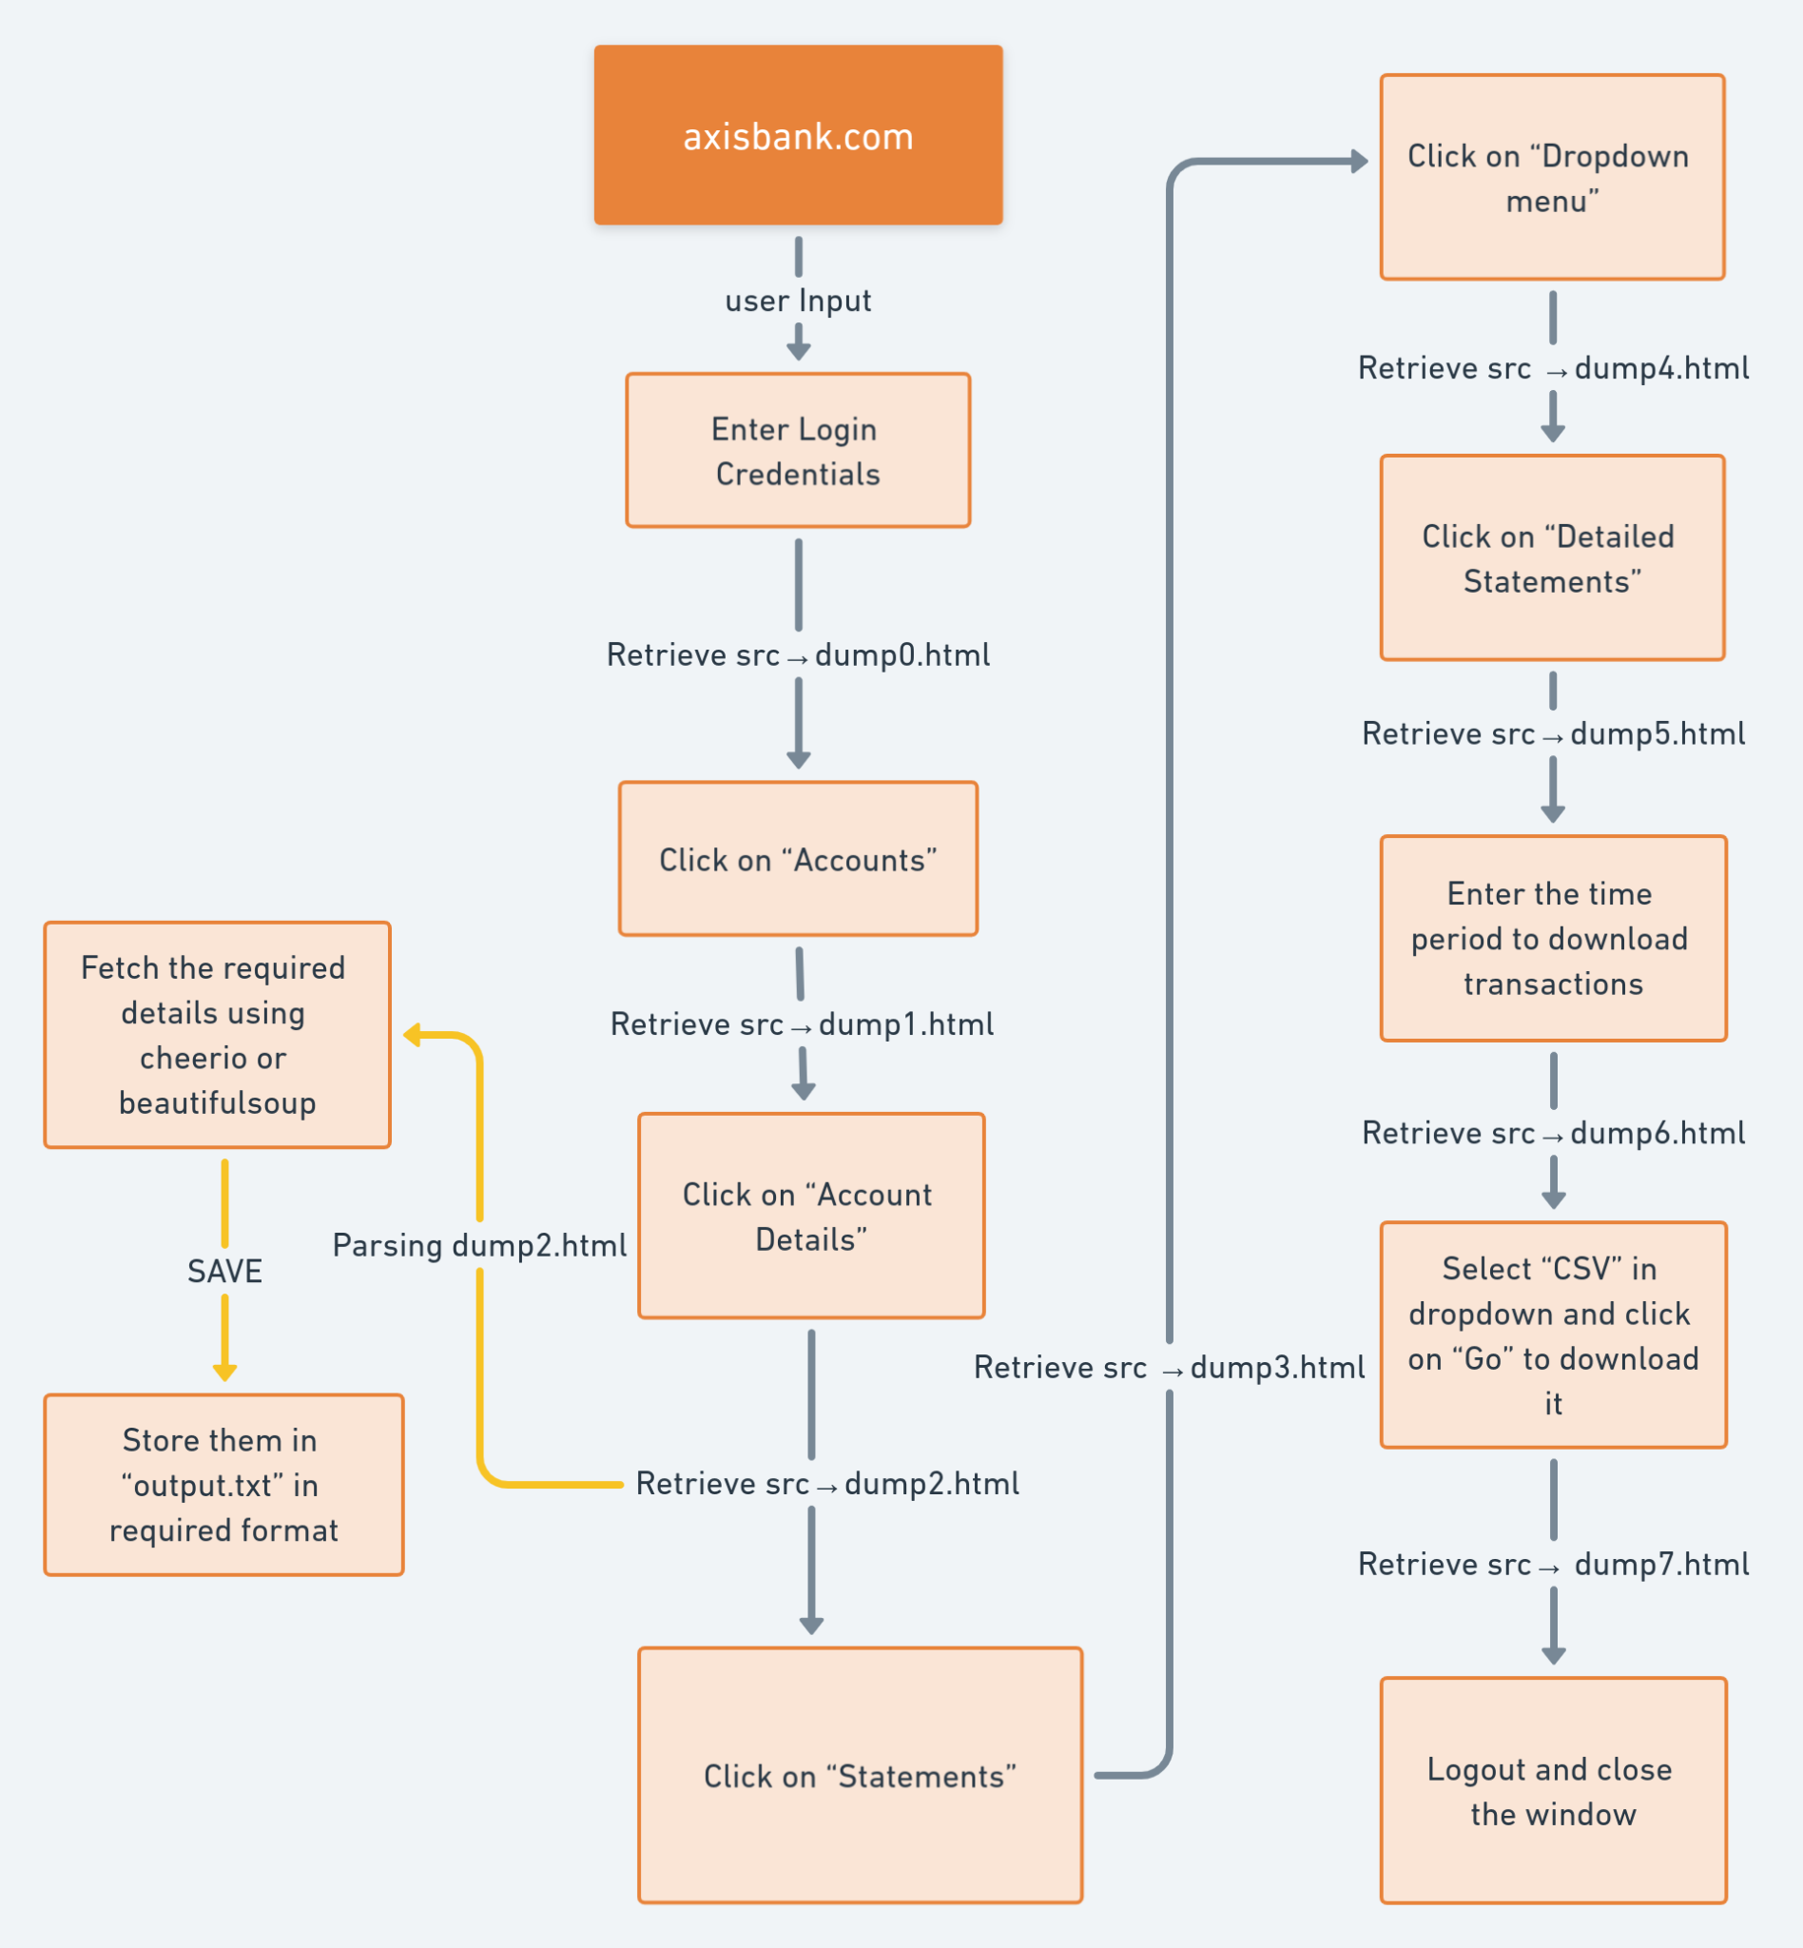
Flow Diagram of Working Model

Slide 12
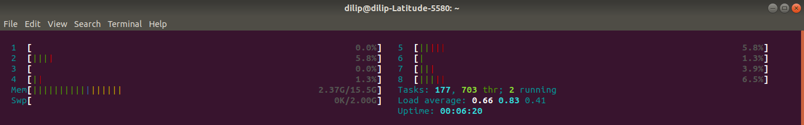
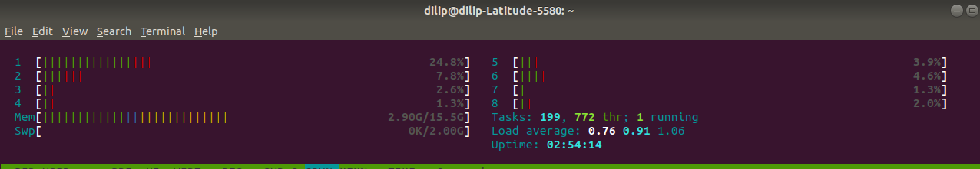
Memory Allocation (RAM)
Puppeteer Javascript
Selenium Python

Slide 13
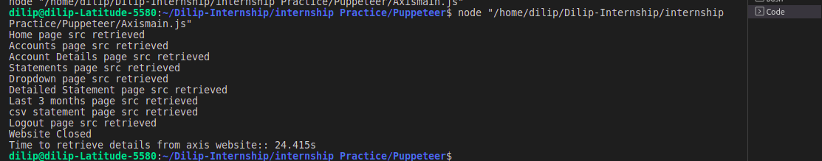
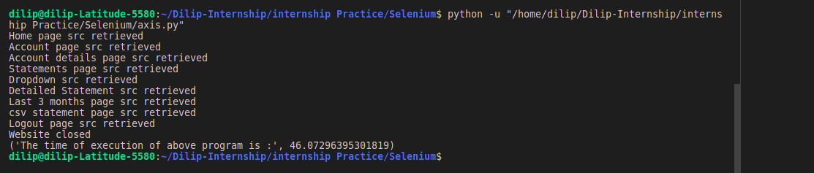
Execution Time
Puppeteer Javascript Avg time:23.55 sec
Selenium Python Avg time:45.56 sec

Slide 14
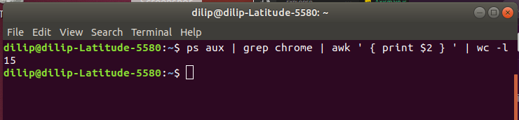
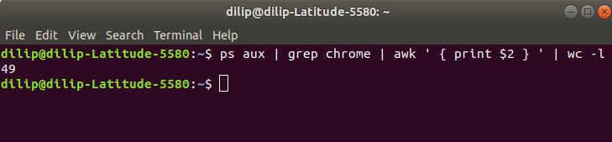
Chrome Child processes running
Puppeteer Javascript
Selenium Python

Slide 15
Thank You!

